Slide 1
Medway’s JSNA
David Whiting
Consultant in Public Health
Medway Council

Slide 2

JSNA???
“A continuous process of strategic assessment and planning…”
“JSNAs are assessments of the current and future health and social care needs of the local community”
Notes:
And why might R be useful?

Slide 3
Medway context
Requirements
On the web
accordion
Content produced by a number of people
Main chapters with agreed structure
R
New team, new to R
Aimed to use reproducible approaches
First published in 2012

Slide 4
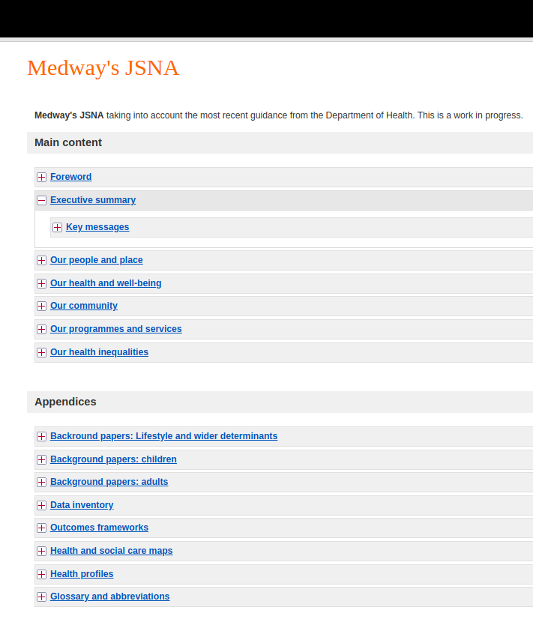
Static website
No copy and paste into CMS
Decided to use markdown
Before rmarkdown existed
(rmarkdown initial commit was 24 Jan 2014)
Created markdown.R
Initial version of website was quite basic
E.g. 23/04/2012

Slide 5
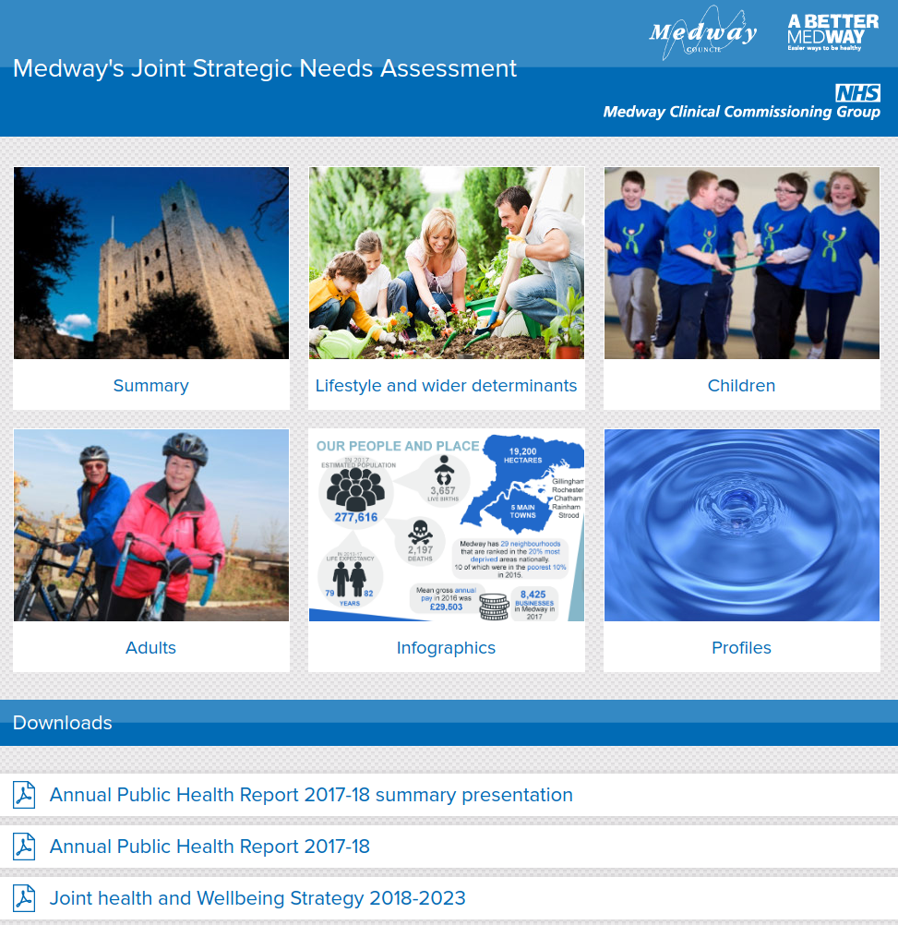
In 2014 we developed a new skin for the JSNA
We pulled it all into git using a bare repository on a local shared drive
(I wish we had started using git sooner)
November 2014 we transitioned from markdown.R to rmarkdown
So JSNA evolved, we didn’t have to re-start. We had some R scripts that re-wrote bits of the whole JSNA

Slide 6
About 800 pages long if printed (similar to first book of Game of Thrones, but with less violence)
Three collections of background chapters
Lifestyle and wider determinants
Children
Adults
Main summary, including demographics
Infographics and Profiles
Far from perfect, we're always trying to make it better
Public Health Intelligence team are the "custodians" of the JSNA
Editorial role
Notes:
Two common complaints:
It’s too long
X is missing from it

Slide 7
JSNA is a continuous process
It will never be finished
Much of it will be updated, at different intervals
Many parts of it will have the same structure
There are opportunities to be constructively lazy by automating parts of the process
Notes:
JSNA is a continuous process - Gareth

Slide 8
Structure
A folder with a 0.Rmd file becomes an accordion section
Fragments of HTML created
Main summary
The part that changes most frequently
Where reasonable to do so we embed results of analyses into the text.

Slide 9
Embedding code in narrative
Avoid transcription errors
A perfect audit trail
Facilitates shared-working
Our default practice, for short or long reports

Slide 10
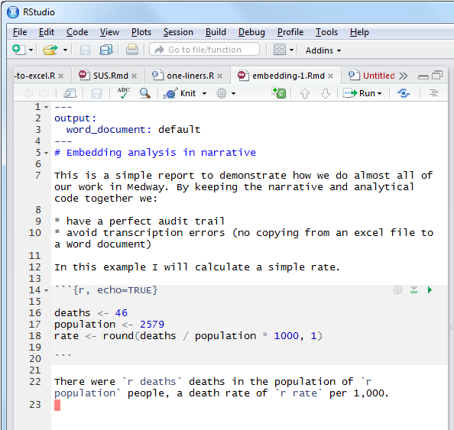

Slide 11
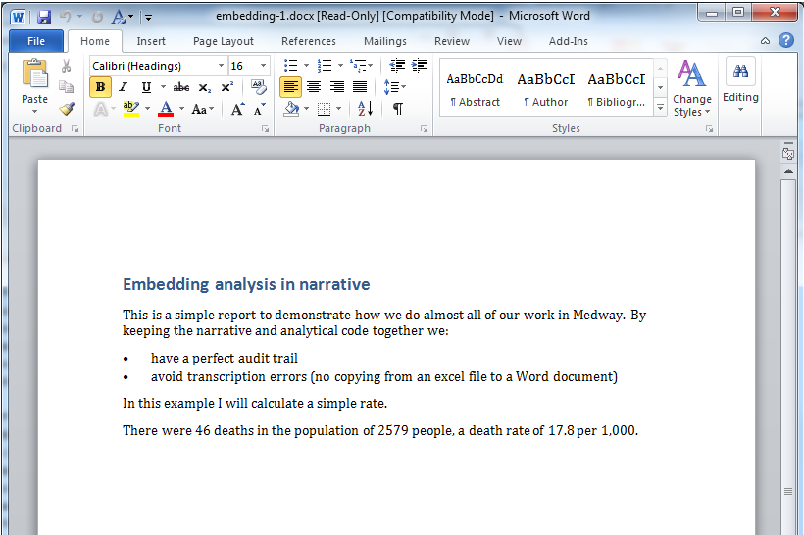

Slide 12
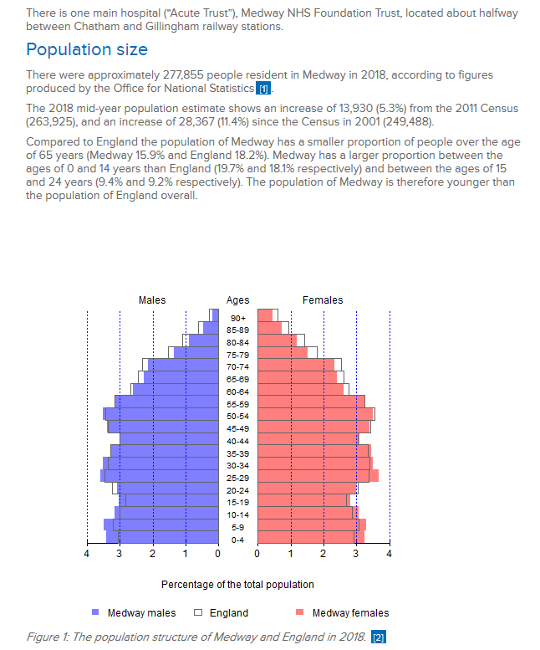

Slide 13
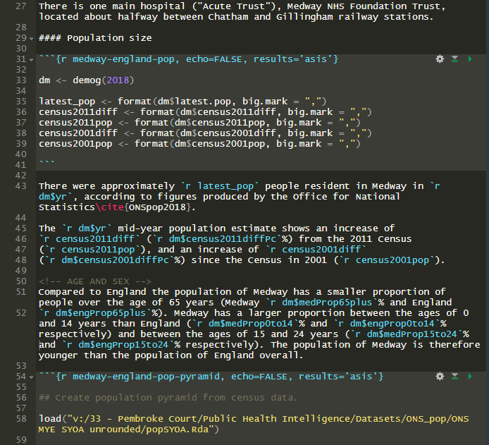
There is one main hospital (“Acute Trust”), Medway NHS Foundation Trust, located about halfway between Chatham and Gillingham railway stations.
Population size
There were approximately 277,855 people resident in Medway in 2018, according to figures produced by the Office for National Statistics[1].
The 2018 mid-year population estimate shows an increase of 13,930 (5.3%) from the 2011 Census (263,925), and an increase of 28,367 (11.4%) since the Census in 2001 (249,488).
Compared to England the population of Medway has a smaller proportion of people over the age of 65 years (Medway 15.9% and England 18.2%). Medway has a larger proportion between the ages of 0 and 14 years than England (19.7% and 18.1% respectively) and between the ages of 15 and 24 years (9.4% and 9.2% respectively). The population of Medway is therefore younger than the population of England overall.

Slide 14
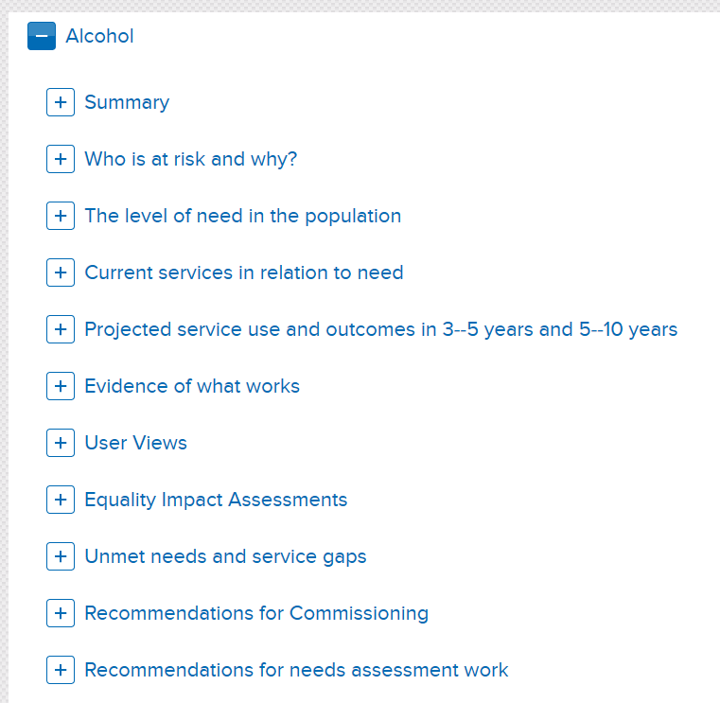
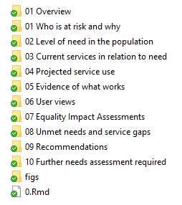

Slide 15
Build process
Each sub-section is in a folder and has a 0.Rmd (fragment) file
We work on the various 0.Rmd files locally, commit, pull, merge, push
Two branches: master; next_release
Build script finds all 0.Rmd files, renders them to create HTML code, and stitches them all together into a small number of larger HTML files
Word versions are built and converted to PDF
The whole lot is copied to a local site location
This can then be viewed and checked before the whole thing is uploaded as a static website (no CMS). Costs £5 per month.

Slide 16
Final thoughts
Still plenty to do
Not reactive (e.g. doesn’t adjust for phones)
Get rid of that accordion! (search; large)
Some bits (really) out of date
Lots of plots are ugly
The codebase has evolved and needs tidying up
But…
It still saves us time
What’s next?
Now running on shiny server so will get interactive
New reactive skin
Re-do plots using ggplot

